Slide 1
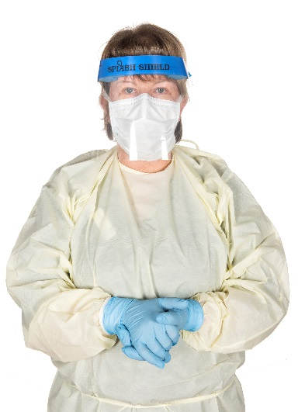
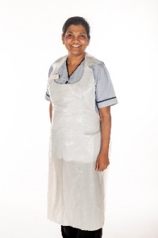
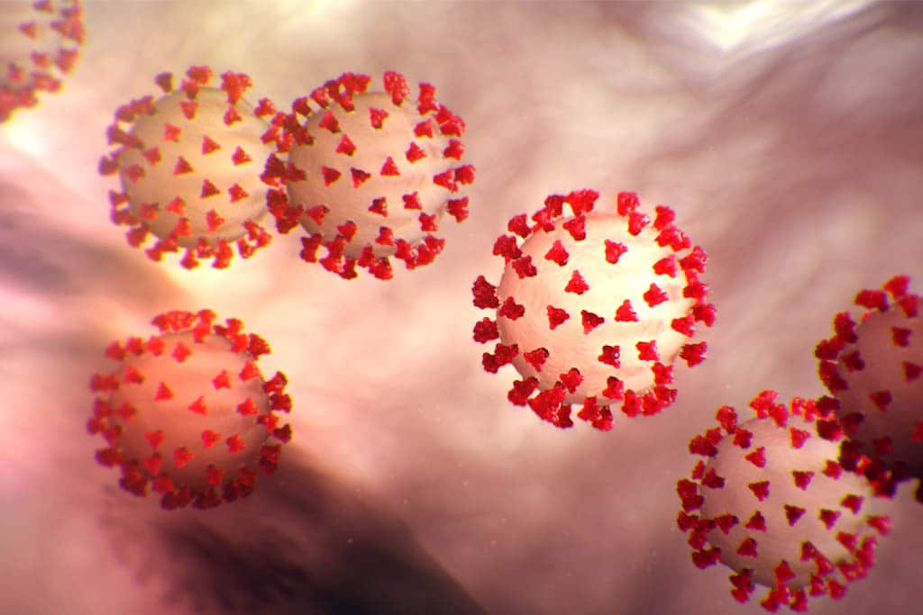
What can I do to help? 1. Clean your hands regularly, especially: when they are soiled, after using the toilet and before eating. If you are unable to go to the sink in your room please ask the nurse Manager for hand wipes.
2. Keeping your hands and body clean are important. Please make sure you have your own toiletries & tissues.
3. When coughing or sneezing use a tissue & turn your head away from others. Dispose of the tissue & clean your hands.
4. Do not touch your wounds, medical devices, drips or catheters.
5. Limit the amount of personal belongings in your room, especially in your bedside locker and table.
6. Please wear a mask when leaving your bed space.
7. Please tell your family that visiting is not allowed at the moment. This is to protect you, your family and healthcare staff. Ask your nurse about virtual visits using technology. Your loved ones can also email messages to SendingLove@tuh.ie which will be delivered to you.
Will my discharge from hospital be affected because I am isolated?
Usually there is no delay if you are returning to your own home. If you are being transferred to a nursing or Residential home or transferred to another hospital you may experience a slight delay as the organisation may need to place you in a single room and this may take time to organise.
Where can I get further advice? For further advice and information, talk to the nurse looking after you or the nurse manager in charge of the ward.
The following are examples of personal Protection equipment worn by staff looks like:
PATIENT INFORMATION LEAFLET
PATIENT INFORMATION LEAFLET
COVID-19
Advice for suspected or positive Patients
We have made every possible effort to make sure that all the information provided in this leaflet is true, accurate, complete and up to date at time of publication.
References: HSE.ie & HPSC.ie
Publication Date:19/11/2020
Version 5.
Patient Care Packages
The Hospital have a patient care package service for relatives. Between 2pm & 4pm seven days a week. Packages for you can be dropped at the parcel desk in the main atrium. Your used clothes can be sent home in a special bag that can go straight into your washing machine without need to open it. Please ask the nursing staff for this bag and to bring it down to the desk for you by 1pm each day.
MPINFEC037-02

Slide 2
What precautions do staff take?
A coloured poster will be placed on the
door to inform staff that certain precautions must be taken. The exact precautions staff will take will depend on the type of task they are doing.
All staff will wear protective clothing coming
into the room if they are having physical contact with you, for example; gowns, aprons, gloves, masks, goggles or eye protection.
Our staff have been trained on how to put
on and take off PPE and how to clean their hands.
If you are not sure if a member of staff cleaned their hands before coming to see you, it is ok to ask them.
Can I leave the room/ bed space ?
No. We ask that you do not leave your room, this is to protect you, the staff and other patients. The door into the room will be closed at all times to help reduce the risk of any infection spreading. If you need to leave your room for treatment or an investigation you will be accompanied and staff will inform you of what precautions you need to take. You will be asked to wear a mask. Please also wear a mask when leaving your bed space.
Being in isolation will not affect the care you receive.
When will my room be cleaned? Your room will be cleaned daily. It is important that surfaces are kept neat so cleaning staff can clean your room and empty the bins.
What is Coronavirus/COVID-19?
Coronavirus/COVID-19 comes from a family of viruses that cause illnesses like the common cold to more severe diseases. Novel Coronavirus is a new strain, not previously identified in humans. COVID-19 is the infectious disease caused by the latest discovered coronavirus.
How does the virus spread?
People catch the virus from others who have the virus through inhaling small droplets when people cough or sneeze or through touching contaminated surfaces. Contaminated hands is the most common way the infection is spread.
What are the symptoms?
Many people experience mild symptoms and recover, but it can be more severe for others. The symptoms include a combination of: Fever, Cough , Difficulty breathing, Sore Throat, sudden loss of taste or smell, Muscle pain & Tiredness
What is isolation and why am I isolated?
This virus can spread easily therefore special care is needed to reduce the risk of spreading it to other patients and staff. Some patients are also more at risk of infection. For these reasons it is necessary to accommodate suspected or confirmed COVID-19 patients in a single room. This is referred to as “isolation”. Patients may also be isolated with other COVID positive patients in a dedicated ward or room also known as co-horting.
The ward staff will explain why you are in isolation and the extra precautions that will need to be taken. We understand isolation may be difficult for you, but the staff will do their best to make your stay in hospital as comfortable as possible.
What about eating or drinking?
Your meals will be brought to you. Your water jug will be filled up when needed. Eat well and keep yourself hydrated.
Can I have visitors?
No, this includes no visiting anywhere on the Hospital campus i.e. outside the Hospital / car park etc. This is to protect you, your family and healthcare staff.
What happens when I go home?
If you are positive and are discharged, you must self - isolate at home until you have no temperature or symptoms for five days and it has been 14 days since you first developed symptoms.
Self isolation means that you must stay at home. Even though your symptoms may be mild you can still spread the virus to others.
Self-isolating will help protect your family, friends, colleagues the wider community and the Health Service.
For further advice on self-isiolating at home please check out the following website.
https://www.hpsc.ie/a-z/respiratory/coronavirus/novelcoronavirus/guidance/selfisolationathome/

